Slide 1
Hotel Reservation System
Presented By :- Sourav Bundele(229098) Guided By :- Mrs. Gauri Kadam
Rupesh Chincholkar(229074)

Slide 2
INTRODUCTION
Hotel Reservation System is a project implemented for all hotels. It provides people all over the world with an easy and fast way to book hotel rooms online.
The interface of the Hotel Reservation System is Web pages that can be accessed with a Web site browser.
Users can perform room booking activities at hotel anytime and anywhere by accessing it via internet.
The Hotel Reservation System is an easy to use application.
Anyone who knows how to use Web browser can easily carry out booking , add hotel to wish lists , see the booking history , see the personal profile .

Slide 3
OBJECTIVES
Computerized system replaces the manual reservation system.
Develop databases which stored user details , booking details and room details.
Create an easy and user friendly environment to user.
User can book a room with an ease.
User can book or make reservation of the room online and in person also.

Slide 4
FUNCTIONAL REQUIREMENTS
System displays the login/registration page.
System accepts the user details if the details are entered in a correct format and store it in the database.
System also allow the user to check the rooms and room details before login.
System can show the available rooms.
System can show you if room is available or not.
System can show rooms on the basis of filter added by the user and show according to it.
System can also ask for filters like breakfast is there , pets are allowed or not , based on their price range ,based on the peoples count and also based on their other requirements.
System should force login before any room booking and if new user is there then provide a link to registration page.

Slide 5
FUNCTIONAL REQUIREMENTS
System also ask for check-in/check-out while booking.
User can see the total number of count days after adding dates in it.
System can show the total price according to the number of count and rate of that room.
System can accept the details and make a record on the database while room booking.
There are separate user interface for each roles means there are 3 different UI for user,admin and for all to free roam on web app.
System can show clients list and room bookings list to admin only.
System also shows the discounts if it is available for that particular room.
User can also add room to their favorites list.
User can also give reviews or complaint on our portal.

Slide 6
USER MODULE
User can see the hotel information at the home page.
Check room availability.
Fill registration from.
User have to login with given email and password at the time of registration.
User can book after login successfully if room is available.
User can give reviews or query’s after login.

Slide 7
ADMINISTRATOR MODULE
Admin can see all the lists room lists,clients lists and bookings lists.
Admin also have to login first.
Admin can edit the details of rooms and bookings.
Admin can see list of rooms on which he can see which rooms are vacant and which are occupied.

Slide 8
DESIGN CONSTRAINTS
Software Constraints
OPERATING SYSTEM – WINDOWS
DATABASE – MYSQL
WEB SERVER – REACT JS
DEVELOPMENT END – JAVA
Hardware Constraints
PROCESSOR – INTEL or AMD (2 GHz)
RAM – 2 GB
HARD DISK – 100 GB HDD
MONITOR RESOLUTION – 1024 x 768

Slide 9
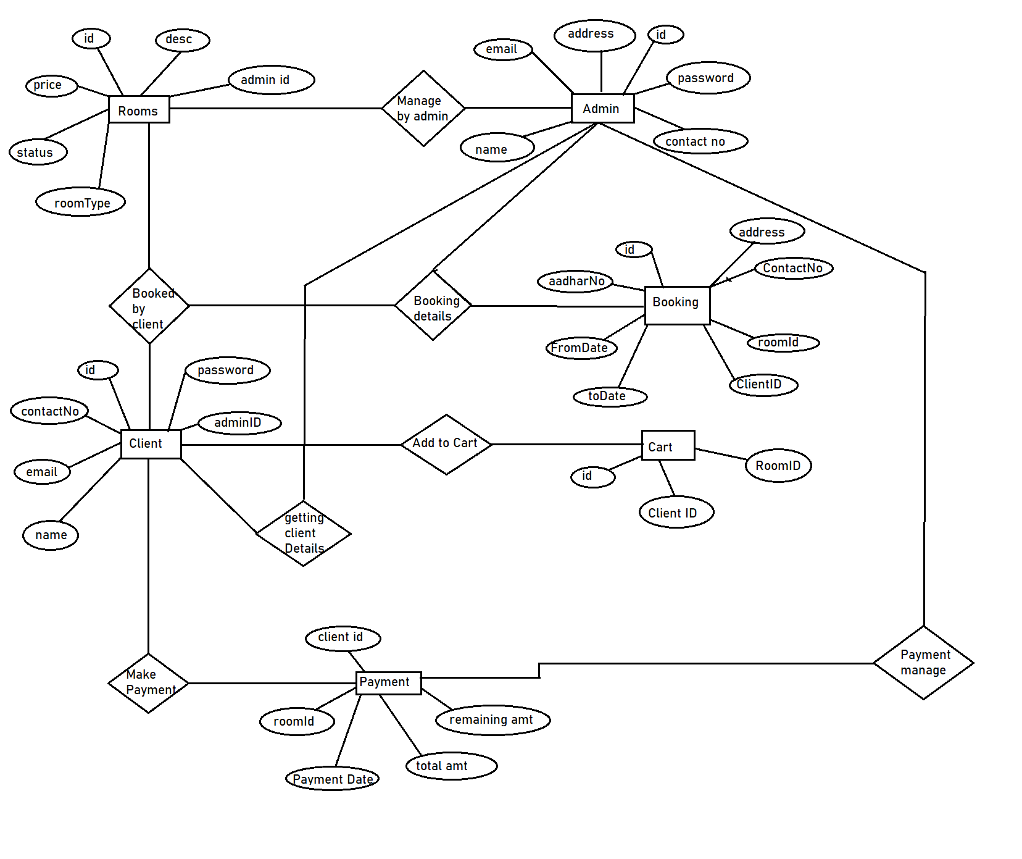
ER Diagram

Slide 10
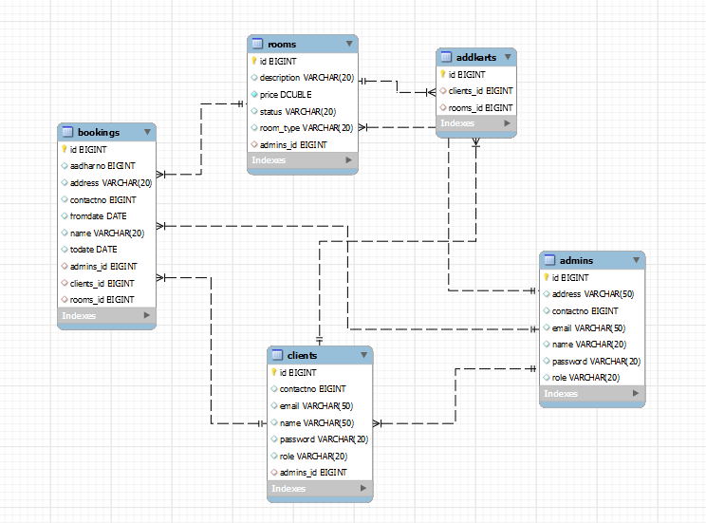
Auto Generated ER Diagram

Slide 11
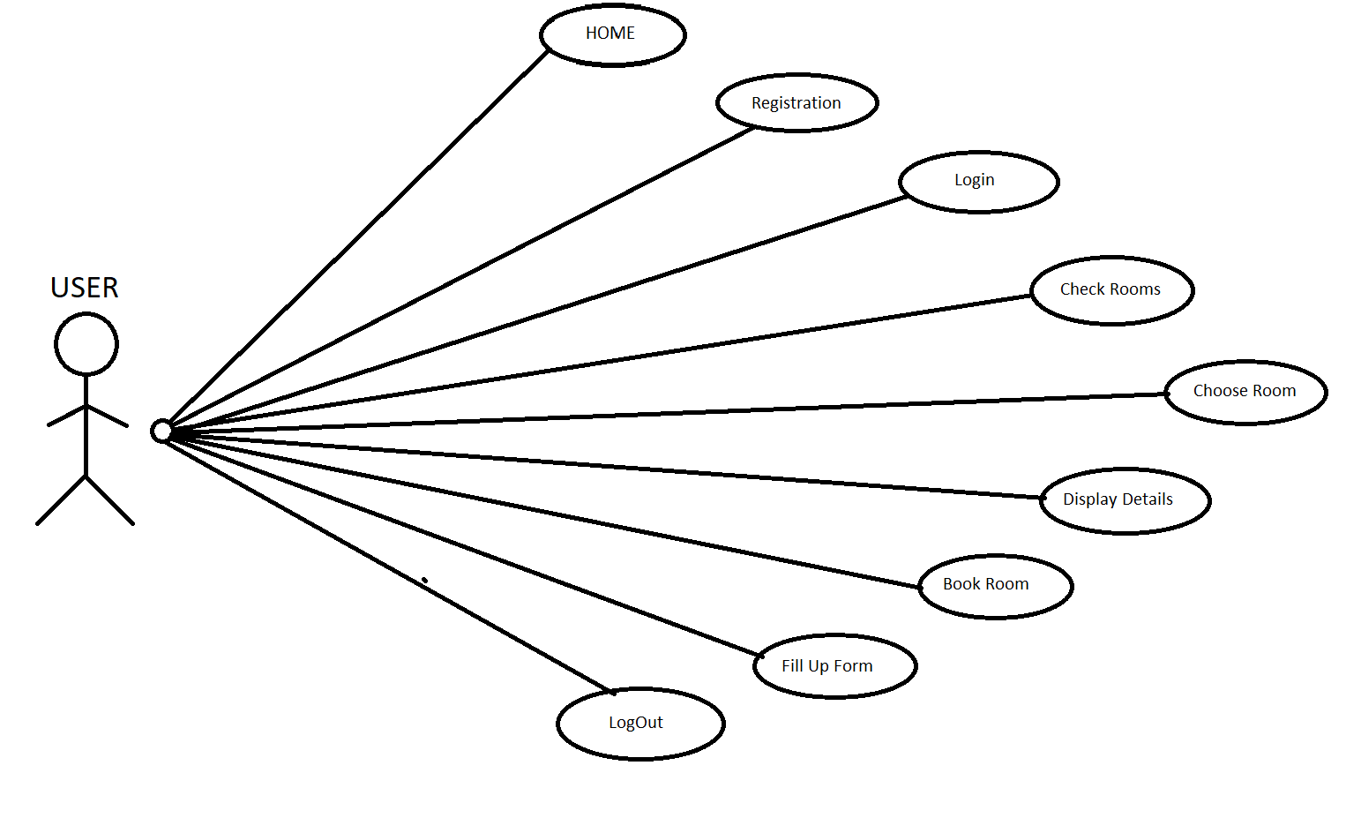
UML DIAGRAM

Slide 12
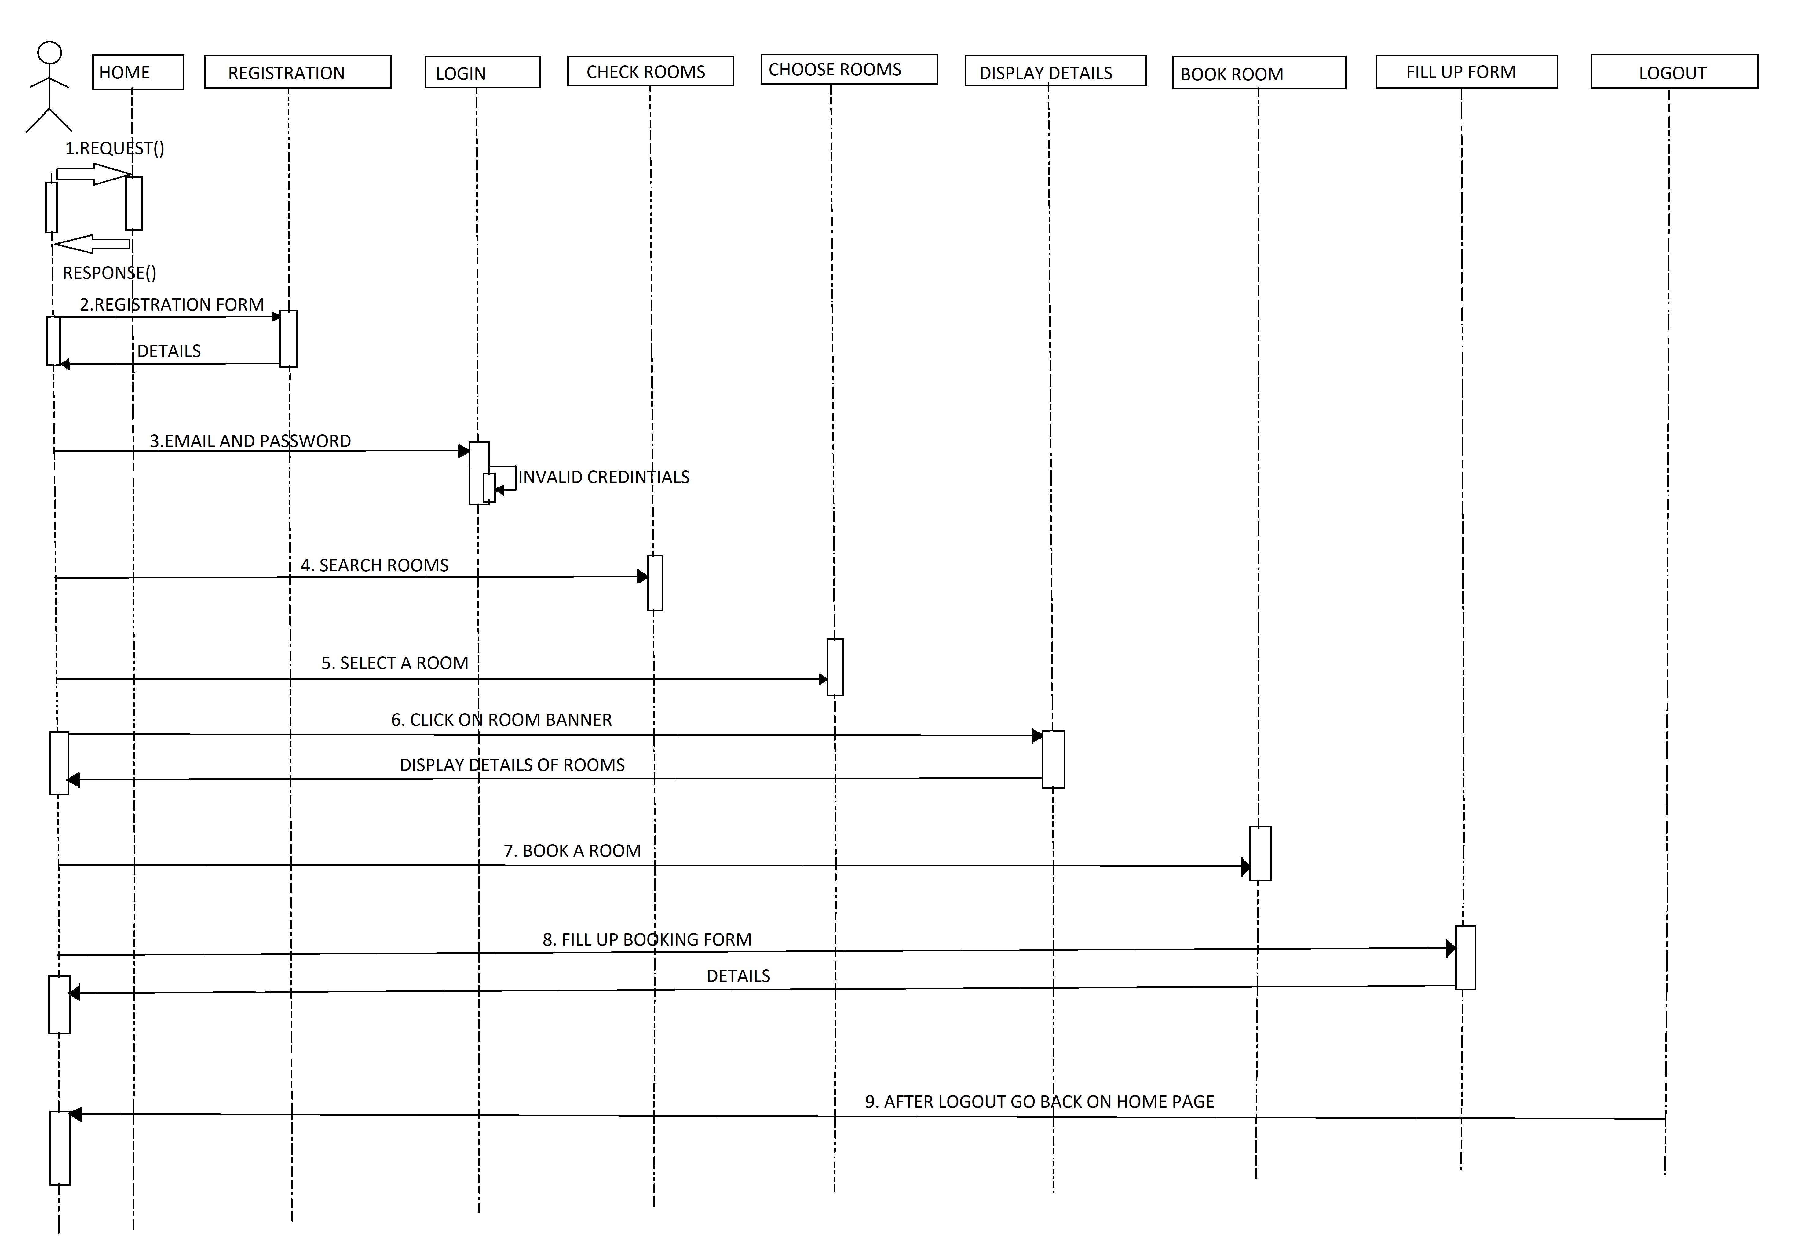
SEQUENCE DIAGRAM

Slide 13
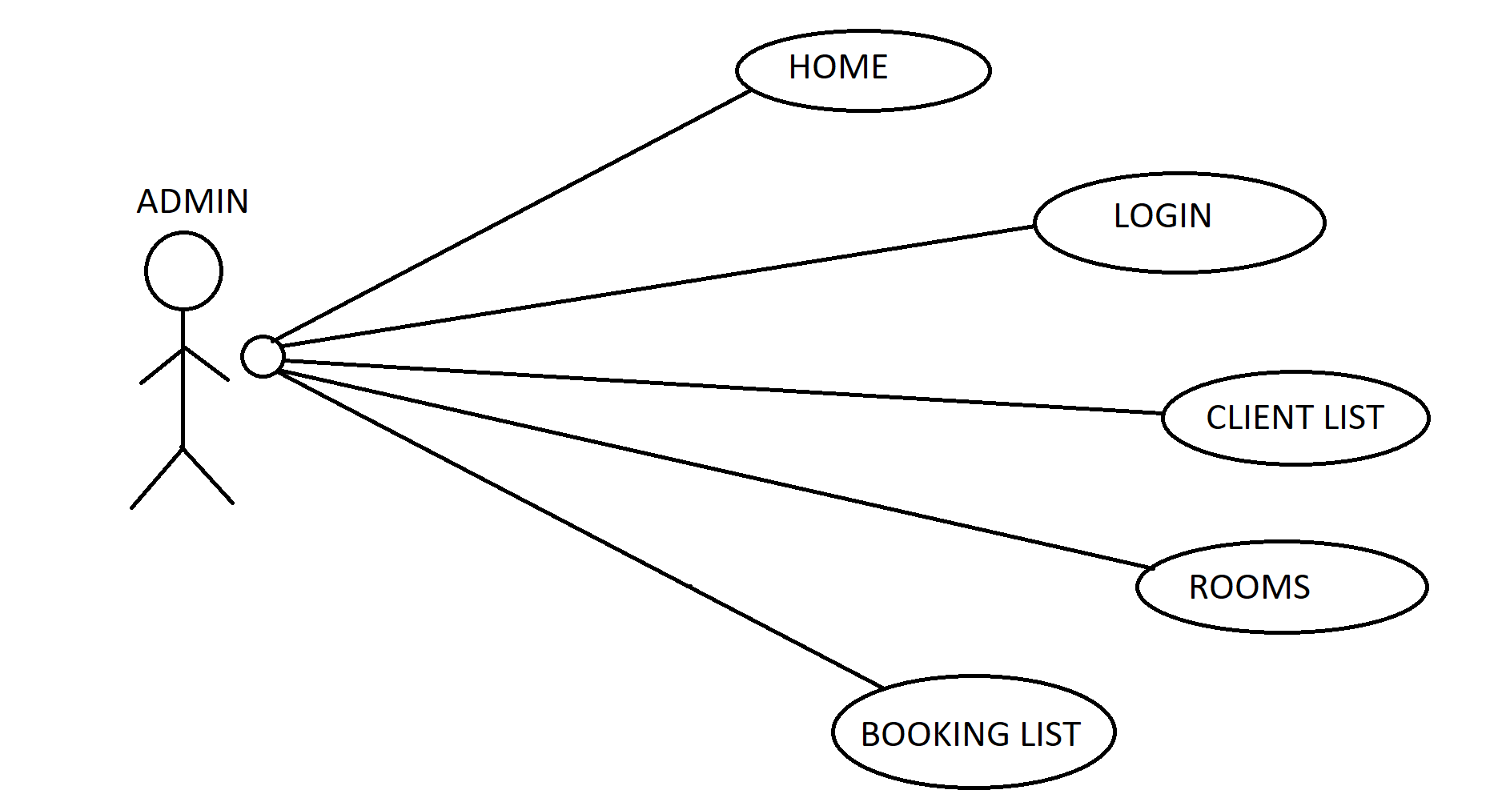
UML DIAGRAM Of ADMIN

Slide 14
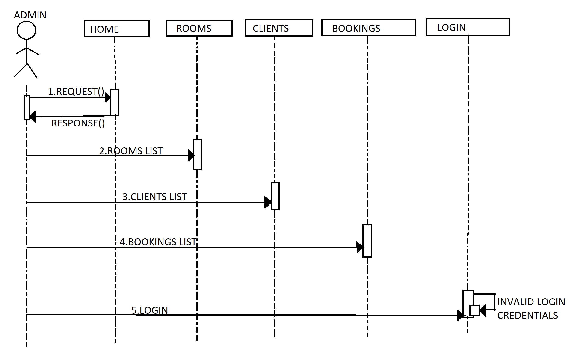
SEQUENCE DIAGRAM OF ADMIN

Slide 15
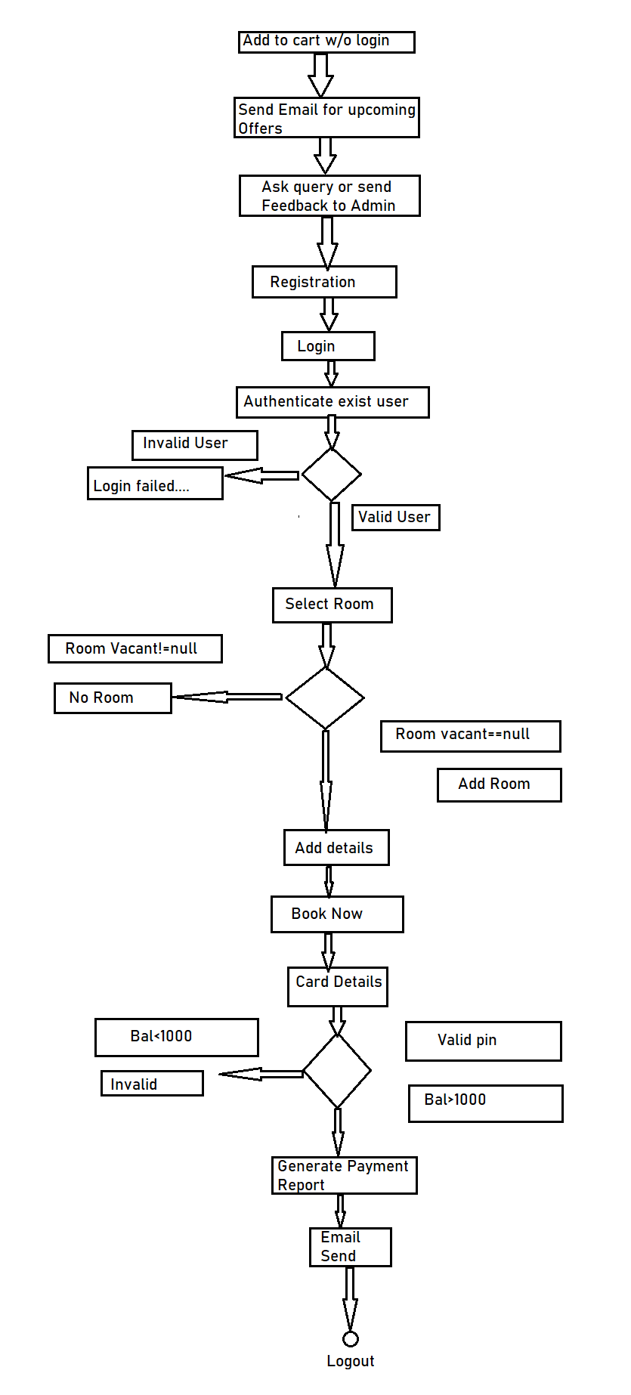
ACTIVITY DIAGRAM

Slide 16
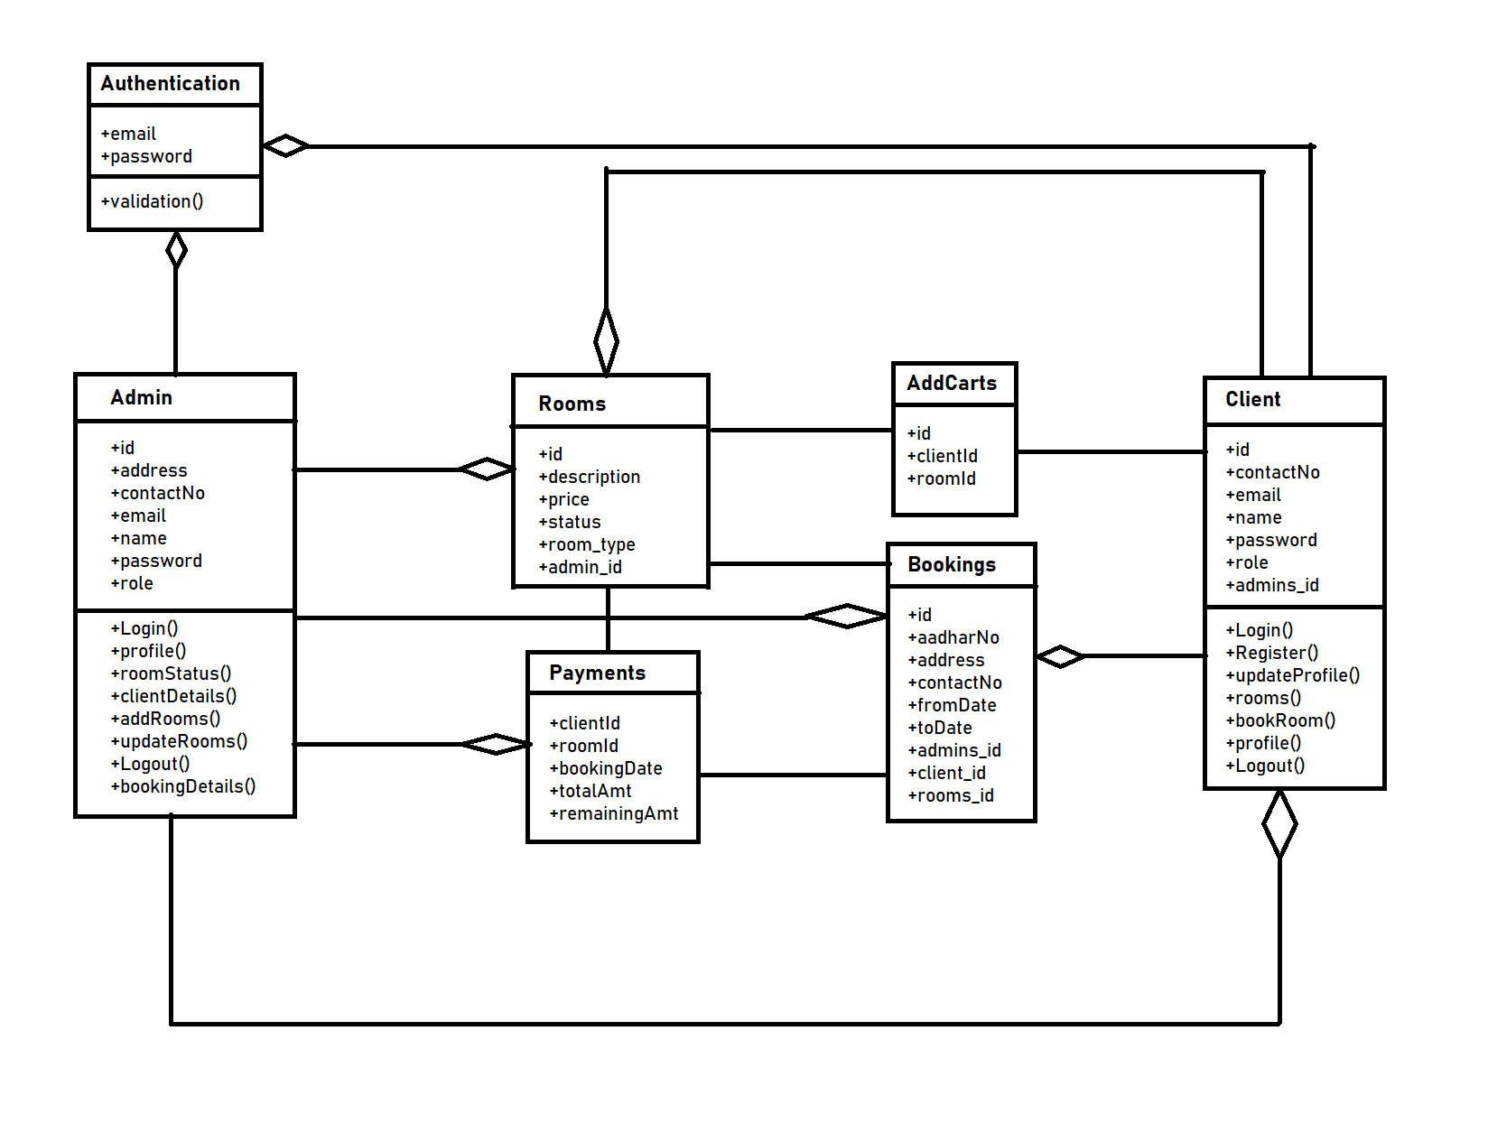
Class Diagram

Slide 17
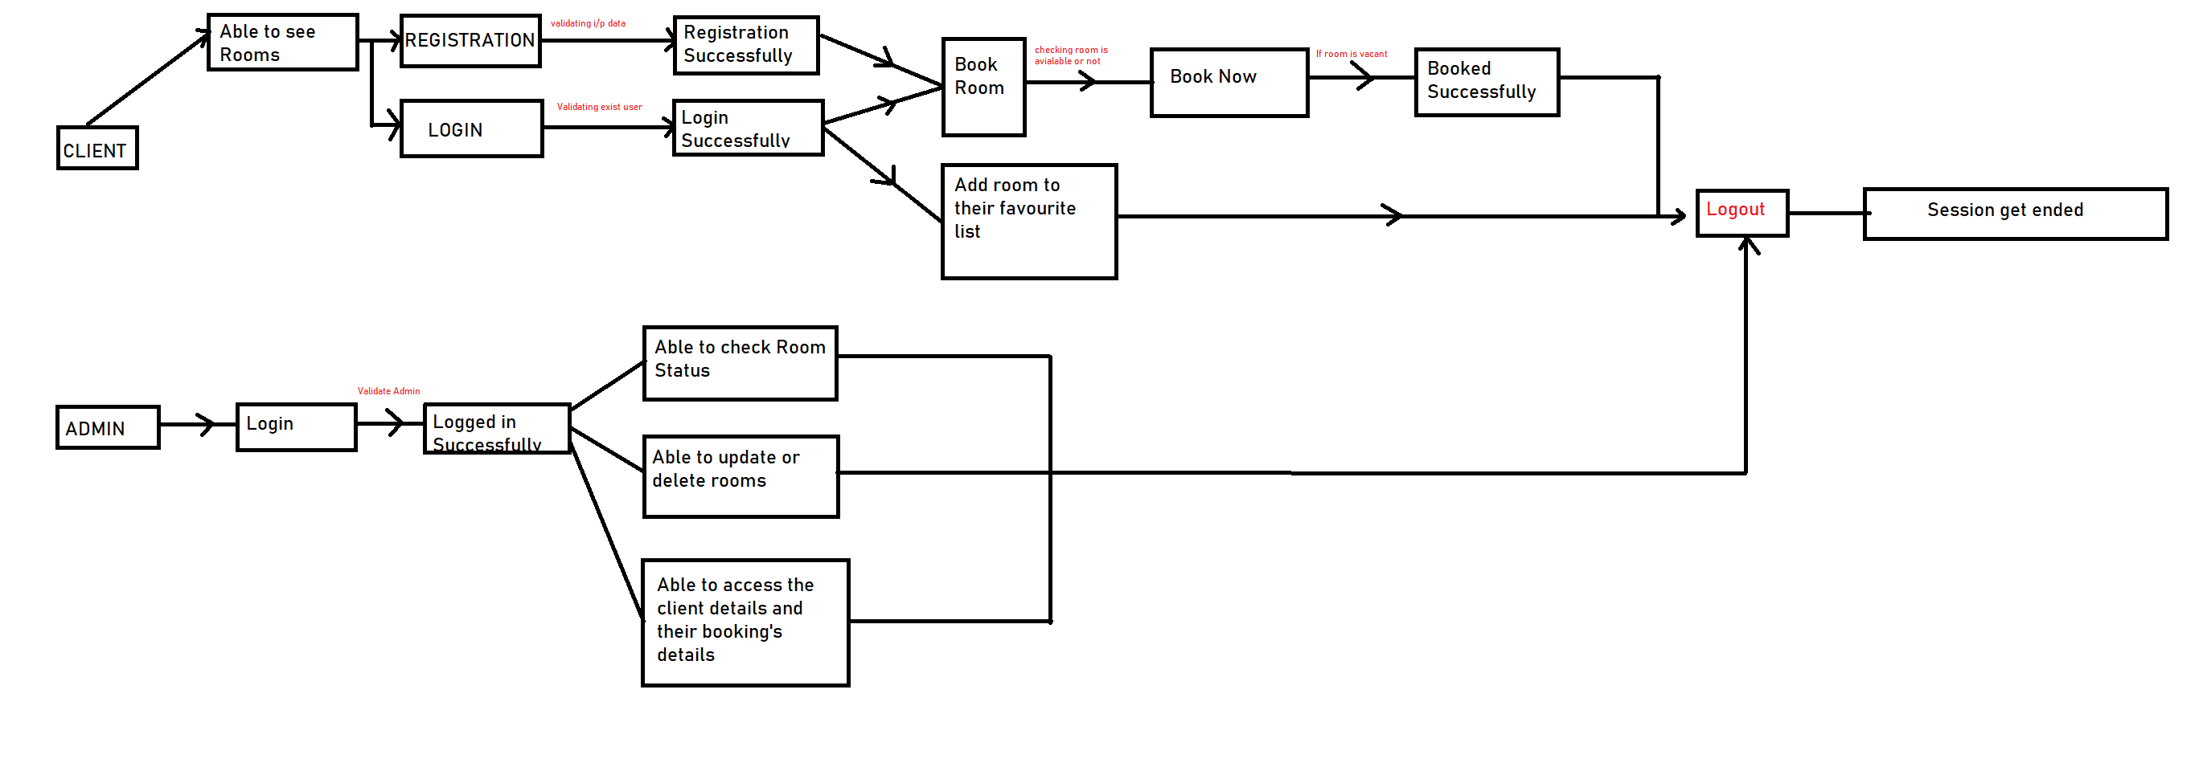
Data Flow Diagram

Slide 18
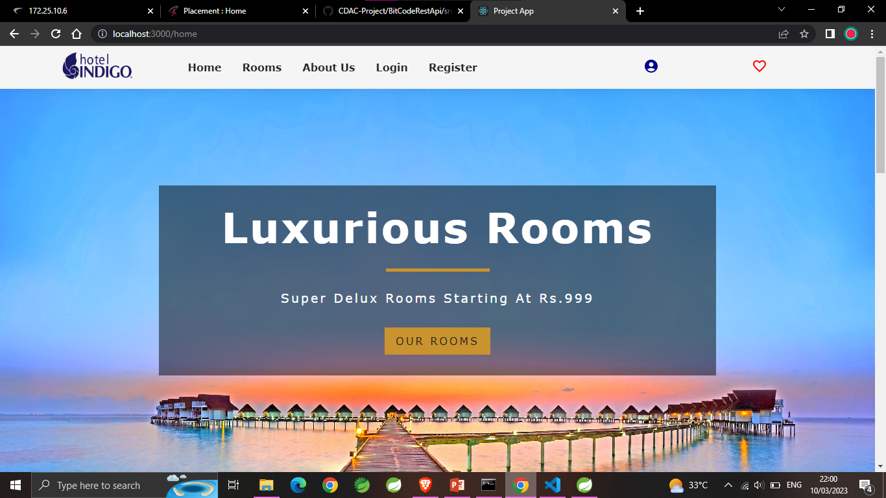
Home Page

Slide 19
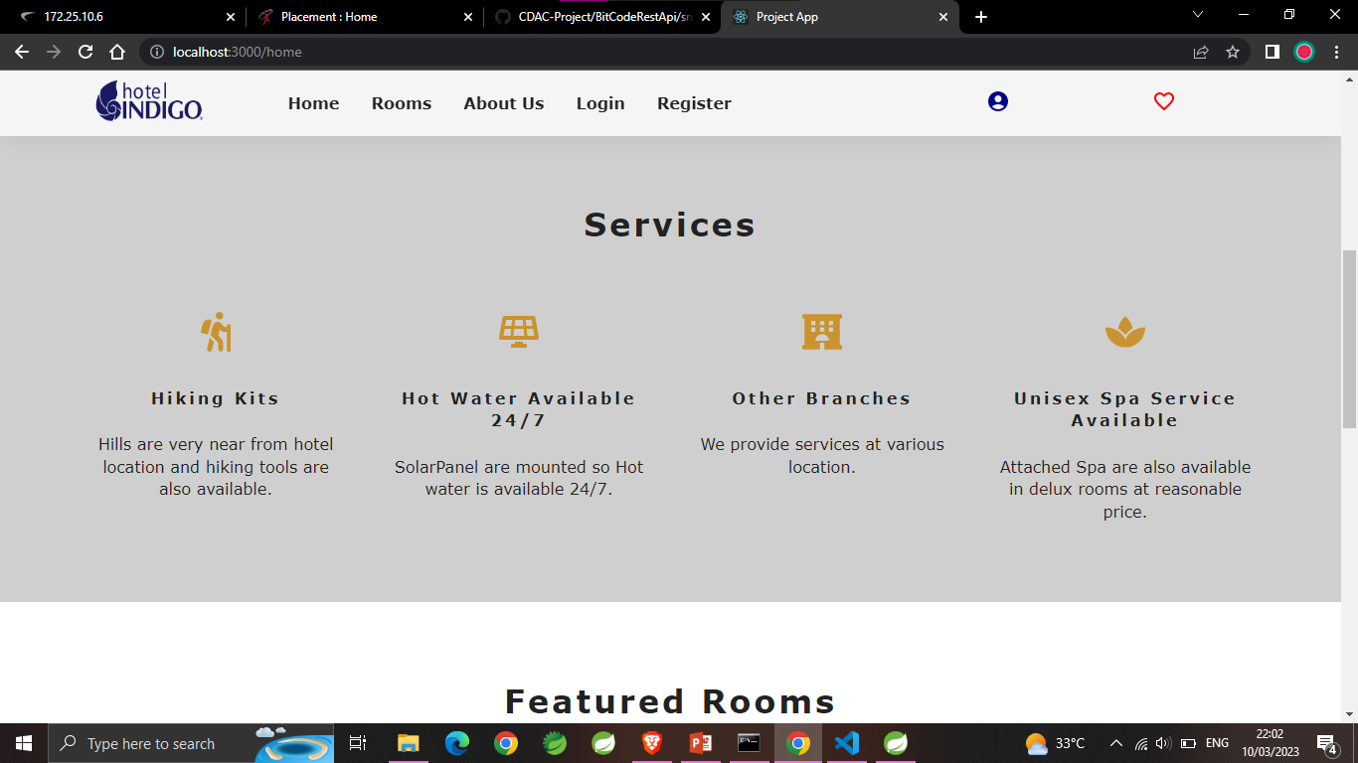

Slide 20
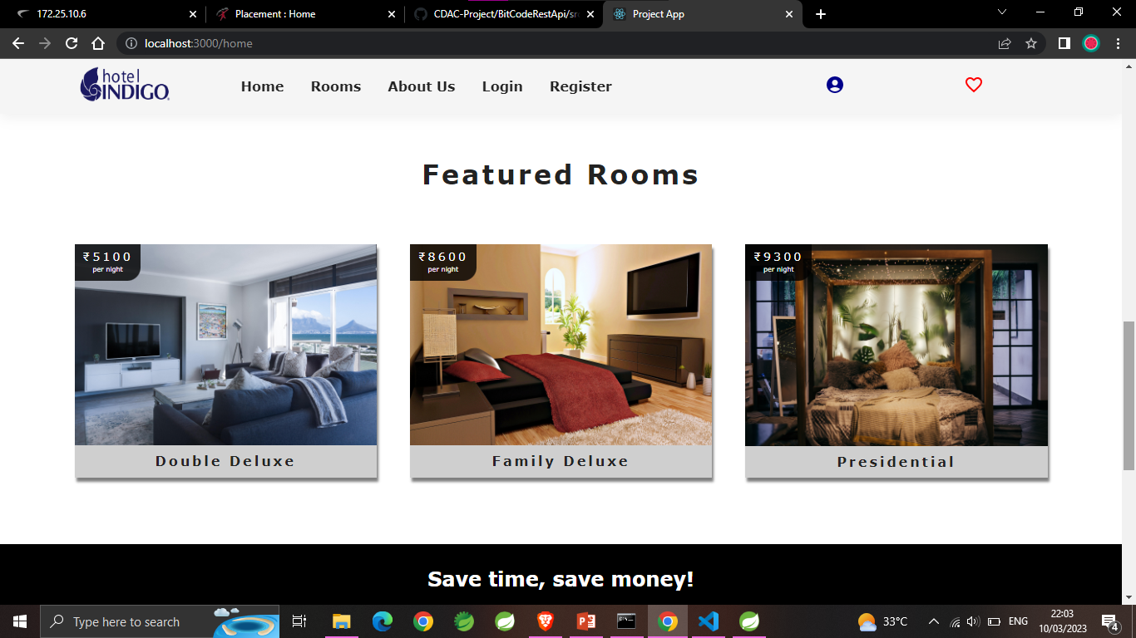

Slide 21
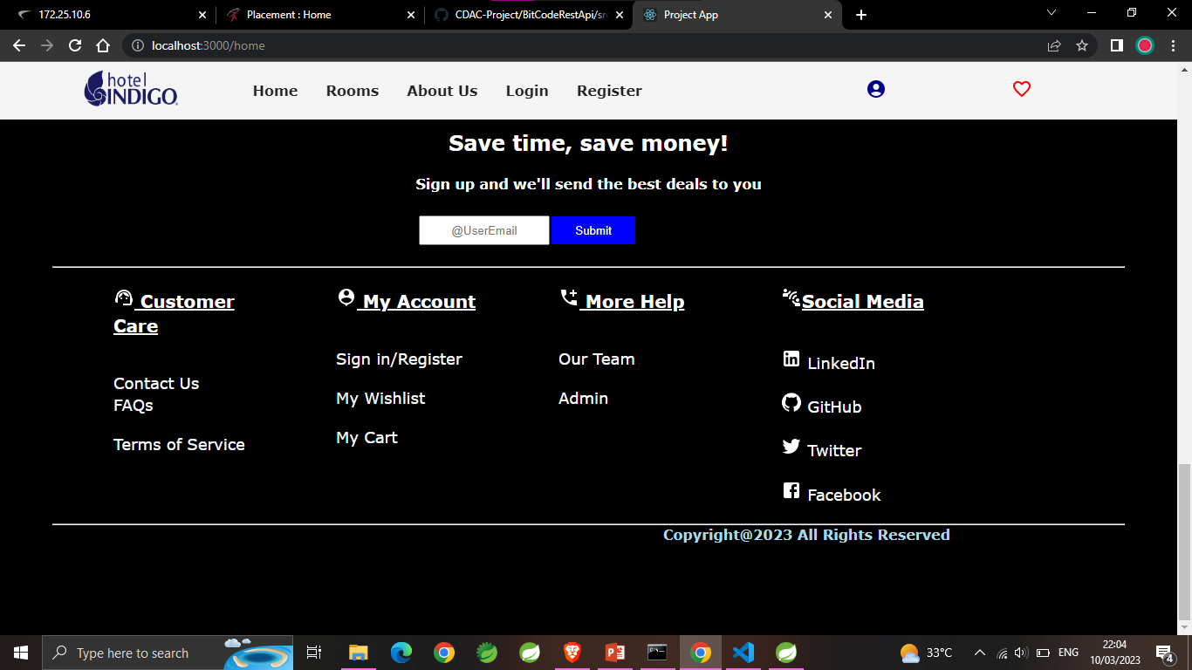

Slide 22
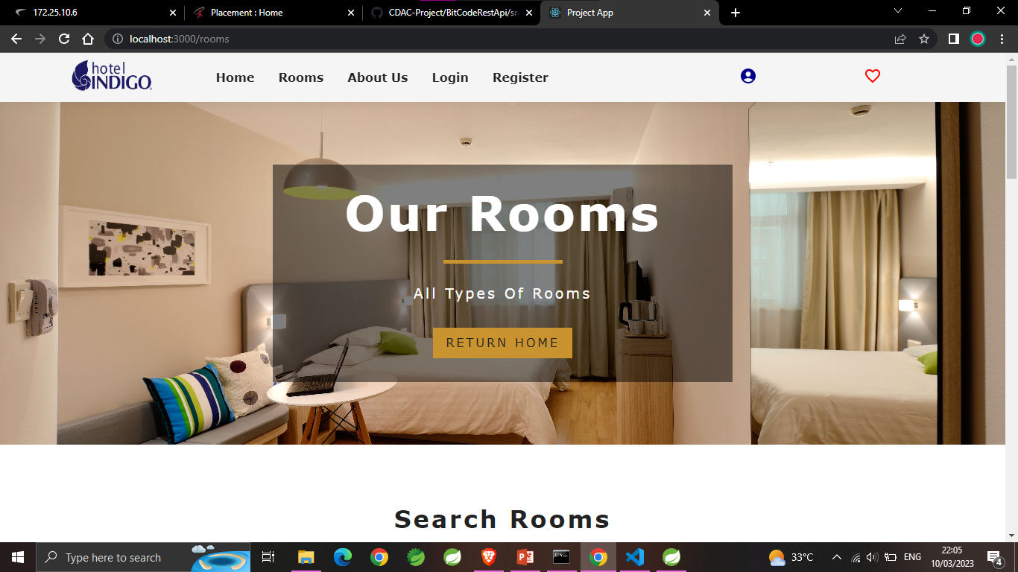
Rooms Page

Slide 23
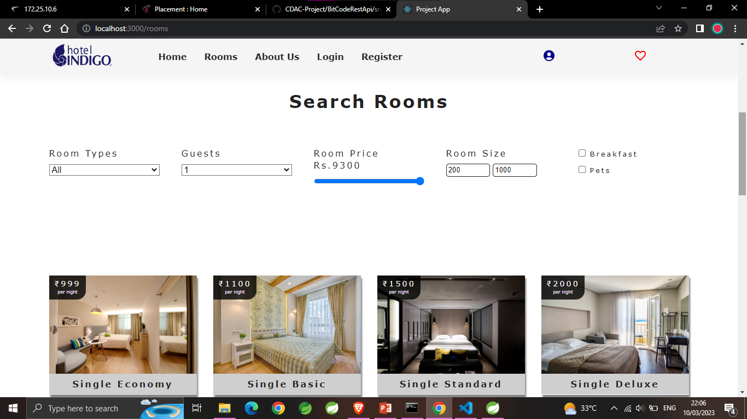

Slide 24
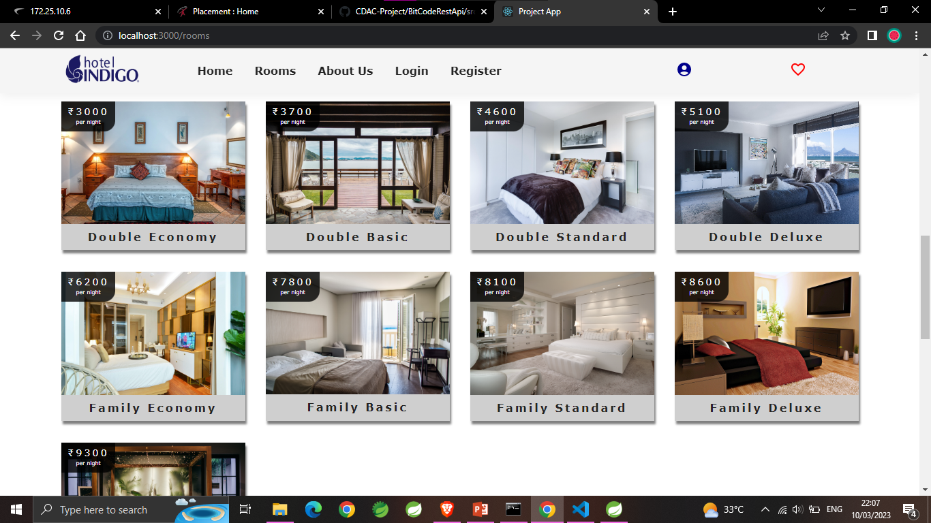

Slide 25
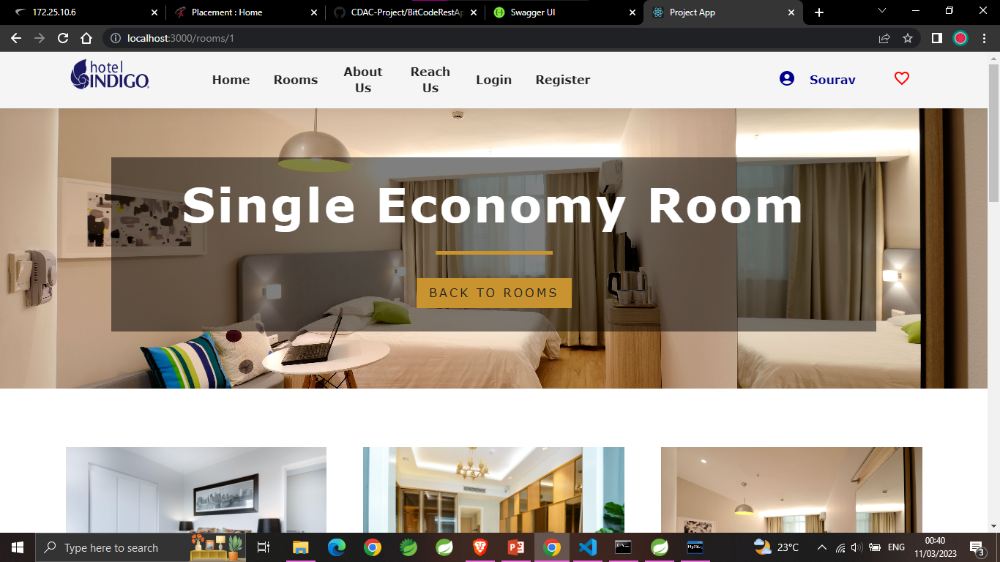
Room Details

Slide 26
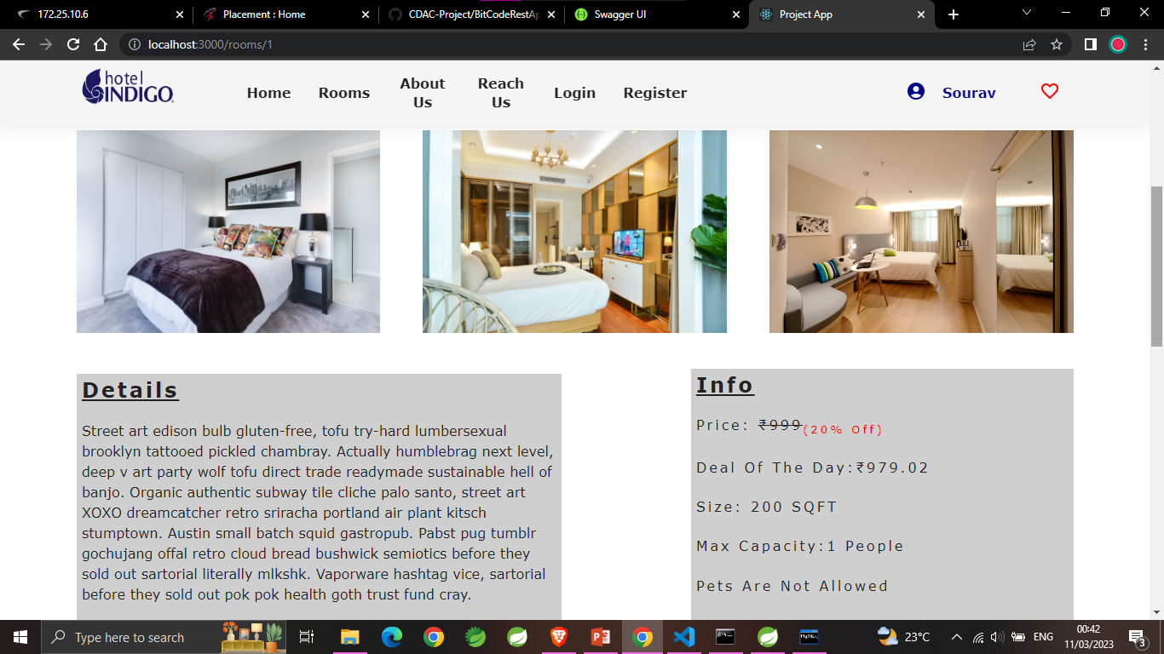

Slide 27
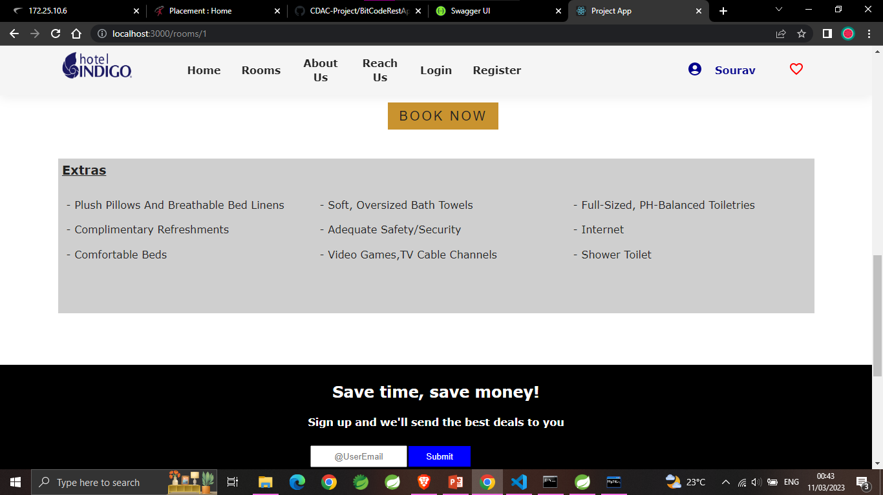

Slide 28
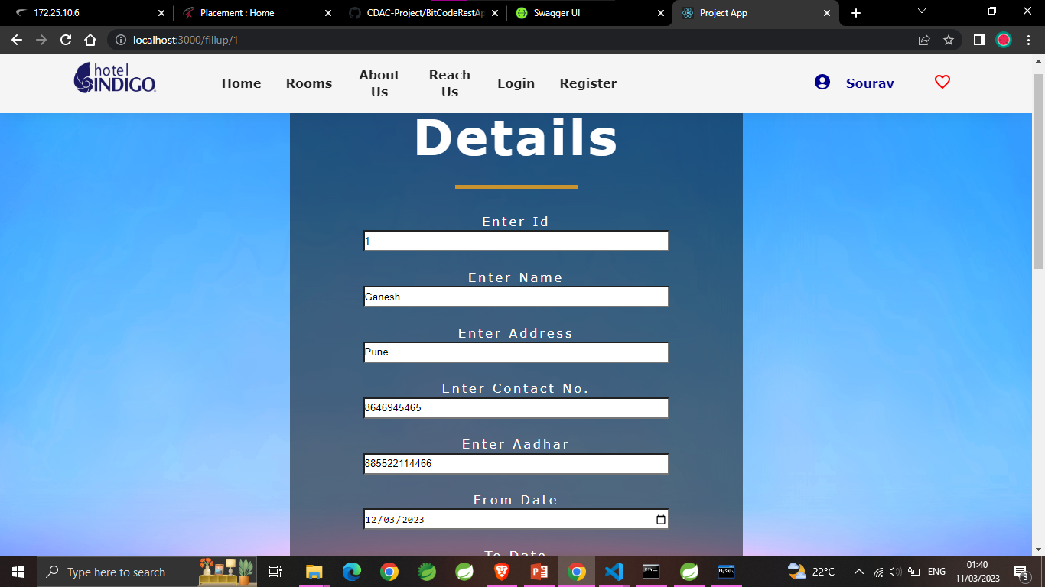
Booking Page

Slide 29
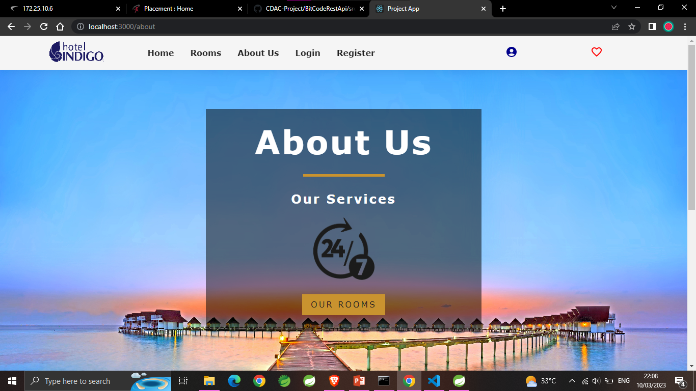
About Us Page

Slide 30
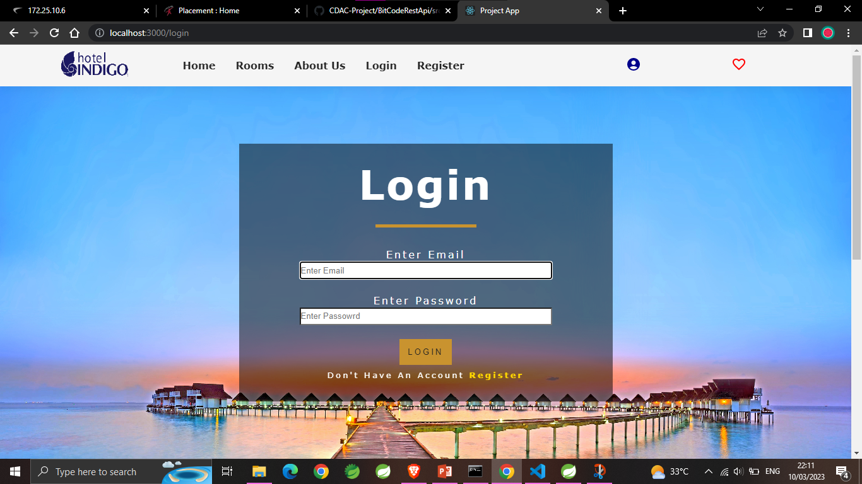
Login Page

Slide 31
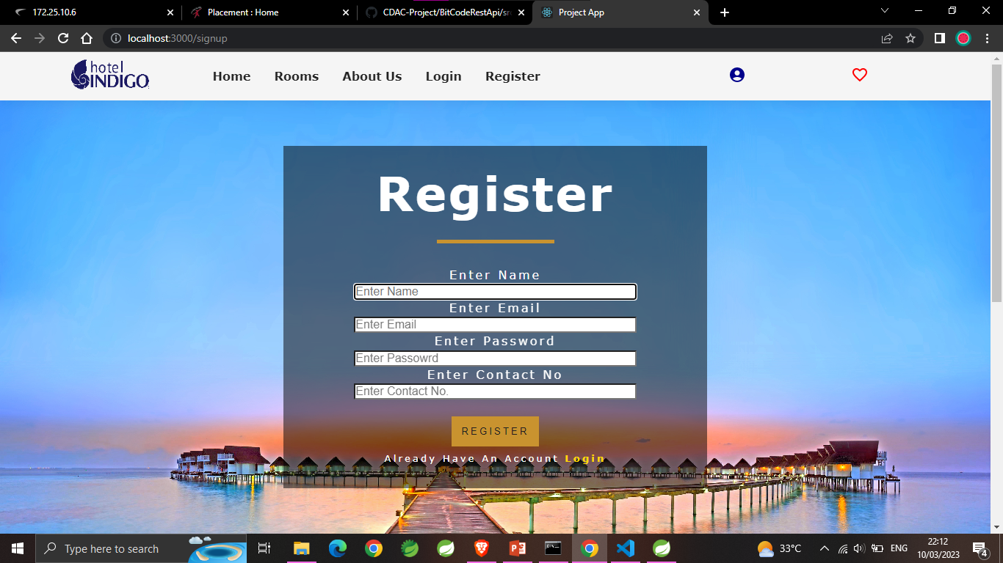
Registration Page

Slide 32
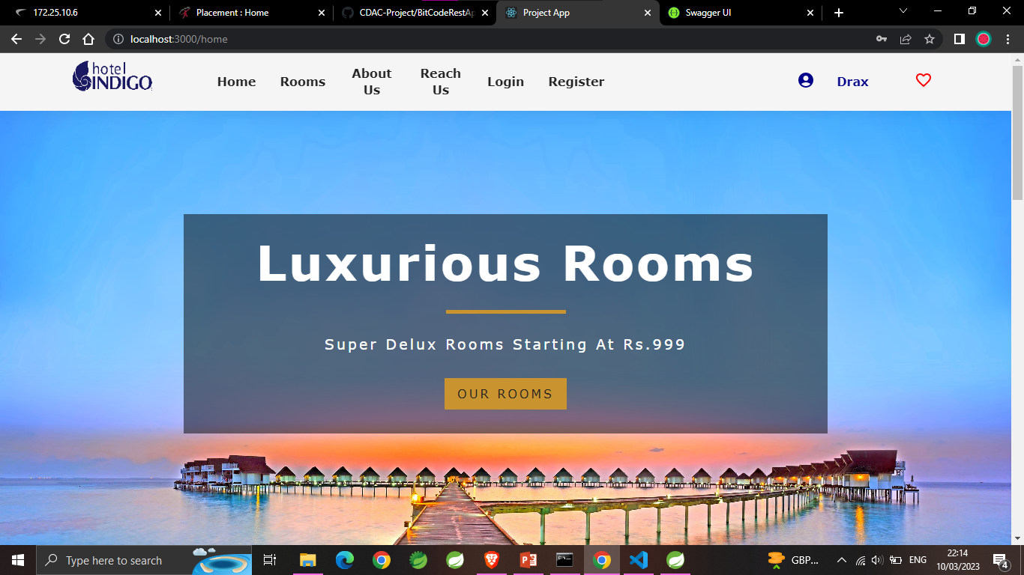
User Page

Slide 33
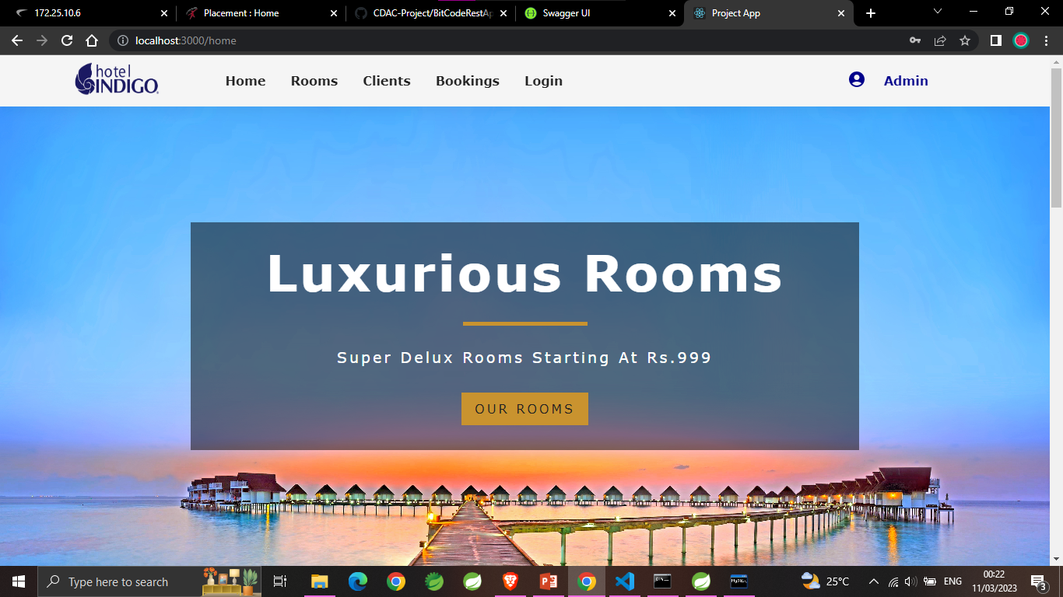
Admin Page

Slide 34
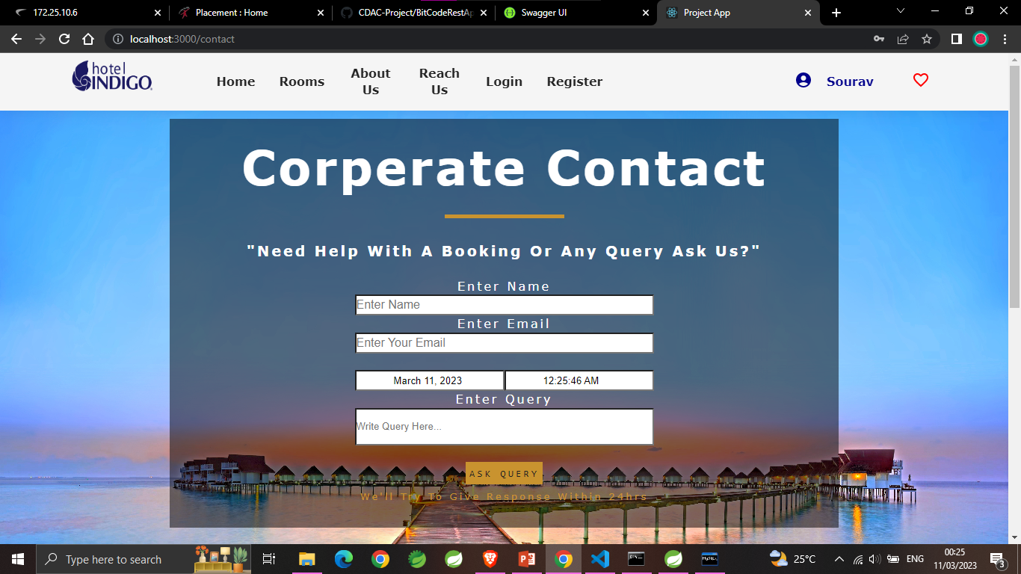
Reach Us / Contact Us

Slide 35
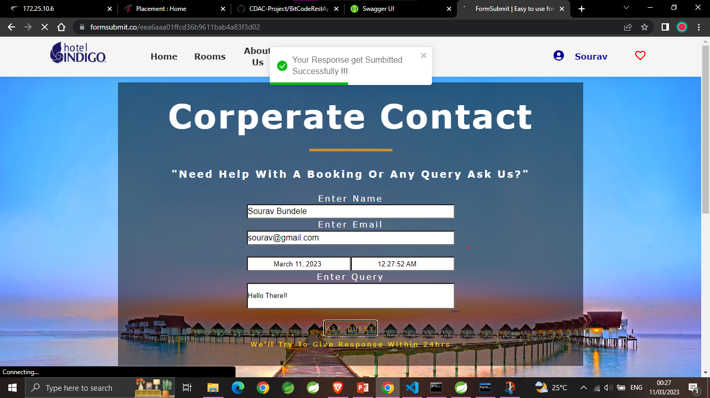

Slide 36
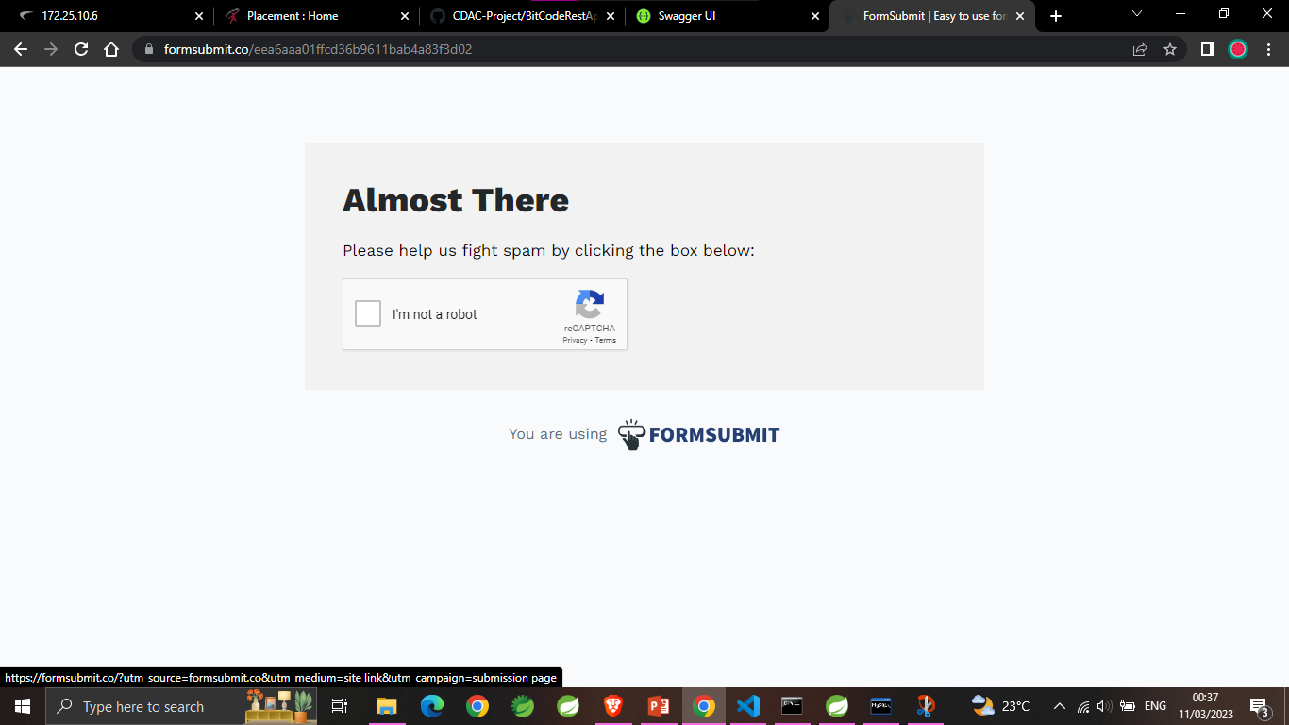

Slide 37
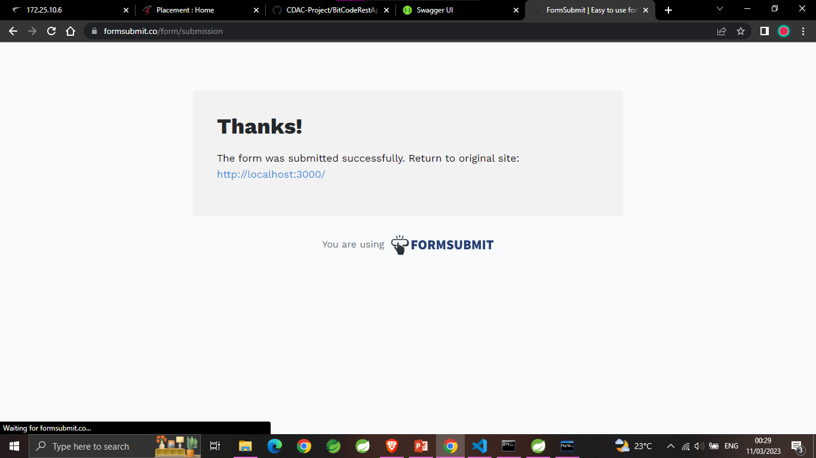

Slide 38
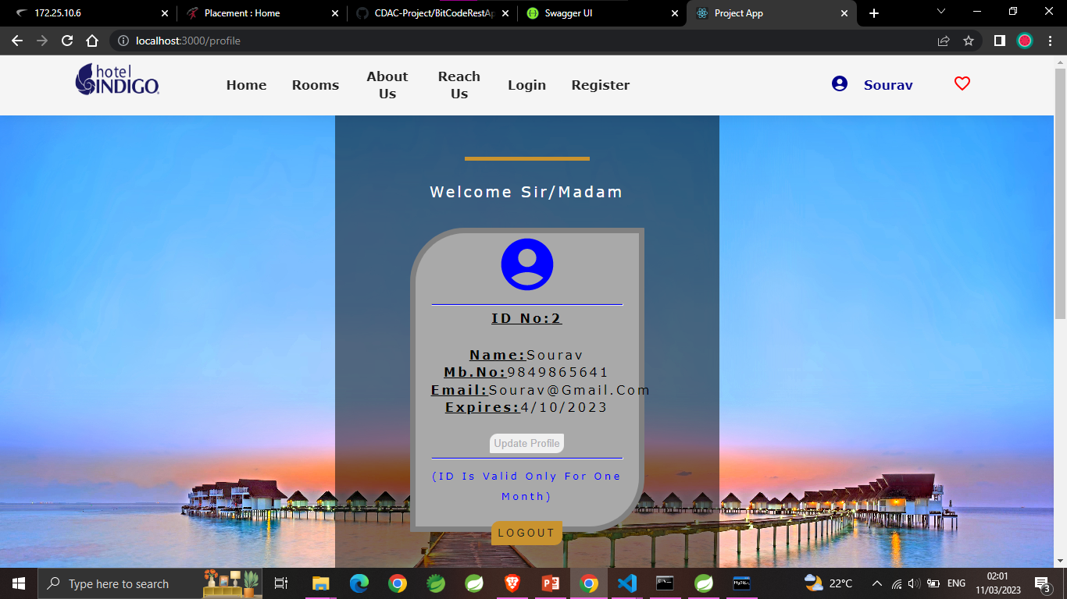
Profile

Slide 39
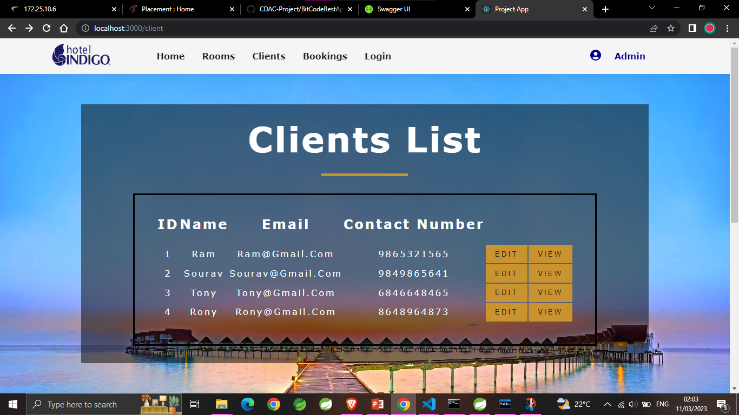
Client List

Slide 40
Conclusion
The project entitled HOTEL RESERVATION SYSTEM was completed successfully.
The system has been developed with much care and free of errors and at the same time it is efficient and less time consuming.
The purpose of this project was to develop a web application for room booking in hotels.
This project helped us in gaining valuable information and practical knowledge on several topics like designing web pages using React.js, usage of responsive templates, designing of web applications using spring boot JPA, and management of database using MySQL.
Future scope is that we wished to implement was it can be done for number of hotels in a single web app.

